Slide 1

Predicting Future Sales demystifying the qualities that drive booze ‘R’ US’s liquor sales
Martin Hsu, Andrew Kerr, Erik Luu, Matteo Shafer, and Isabella McCarty
Notes:
Intro – Martin – 45sec
Project Scope – Matteo – 45sec
Model Fitting – Eric – 45sec
Key Findings – Martin – 30sec
Conclusion – Matteo – 15-30sec

Slide 2
INTRODUCTION
BOOZE ‘R’ US RFP
ANALYSIS OBJECTIVES
DATA COMMUNICATION
Notes:
Booze ‘R’ Us requested a model that can predict future sales for growth purposes
Analysis objectives: We propose a linear regression model as it is a simple yet powerful statistical model for understanding relationships. We want to produce a model that predicts future sales accurately
Data Communication: Using a business case study, we’ve produced a model that balances prediction and providing granular insights into what drives sales growth. The following is an example of what our modeling program.

Slide 3
PROJECT SCOPE -DATA COLLECTION-
IOWA LIQUOR SALES API
CASE STUDY: CASEY’S GENERAL STORE, 2017-2020
LIQUOR TYPE, SIZE, COST, TIME PERIOD
IDENTIFYING POSSIBLE SALES FACTORS
FEATURE ENGINEERING
ANALYTICAL METHODS AND CUSTOM FACTORS
ESTIMATE SALES WITH STORE PURCHASES
Notes:
We got our data from API and singled out “Casey’s General Store” 2017-2020 as it matches Booze ‘R’ Us business model
We looked at variables: -Month, Year, Full Packs Sold, Single Bottles Sold, Bottle Size Category, Bottle Price Category, Alcohol Category
Feature Engineering: We will categorize liquors into small and large sizes. Similarly, we will categorize the sale price per bottle into three categories: cheap, average price, and expensive. Also, categorizing each alcohol into specific categories: Vodka, Tequila, and etc.
We aggregated the data so each observation is identified by a month, year, and store front

Slide 4
PROJECT SCOPE -MODEL FITTING-
​ MODEL RANKING​ ​ | ​ FEATURES IN MODEL​
1​ | MONTH, BOTTLE SIZE, BOTTLE COST, LIQUOR TYPE
2​ | YEAR, BOTTLES SIZE, BOTTLE COST, LIQUOR TYPE
3​ | BOTTLE SIZE, BOTTLE COST, LIQUOR TYPE
MODEL CHOICE: LINEAR REGRESSION MODEL WITH PENALIZATION TERM
VARIOUS COMBINATIONS OF FEATURES (PERIOD, SALE VOLUME, SIZE, COST, LIQUOR TYPE)
RIGOROUS VALIDATION PROCESS BY GENERATING AND TESTING MANY VERSIONS OF SAME MODELS
Notes:
Model Choice: Linear regression model with penalization term
Combinations of variables regarding period and volume of bottles sold by size, cost, and
To evaluate our models we used a rigorous validation process that generates multiple versions of the same model and averages their score.

Slide 5
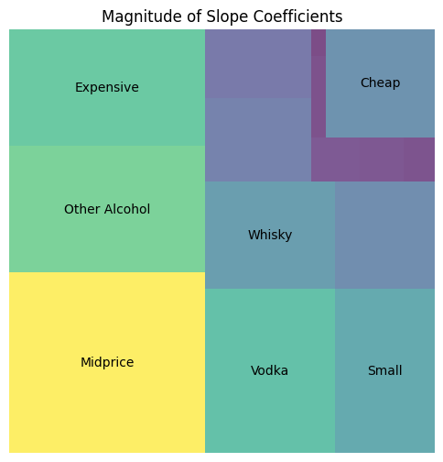
KEY FINDINGS
DETAIL-ORIENTED, INFO-DENSE APPROACH
SEASONALITY - MONTH
VALUE DRIVERS
MIDPRICE ($25-$50), EXPENSIVE (>$50)
SMALL BOTTLES (<750mL)
VODKA, WHISKEY, OTHER
GROWTH OBSTACLES
CHEAP LIQUOR (<$25)
Notes:
- Omitted sale volume (such as bottles sold
Sale Growth Drivers
- Number of expensive, mid price
- Number of small bottles sold
- Other alcohol bottles (Exotic not your typical), Vodka, Whiskey
Sale Growth Obstacles
- Cheap bottles sold
And based on that model results we will see if you guys should expand your operations or not

Slide 6
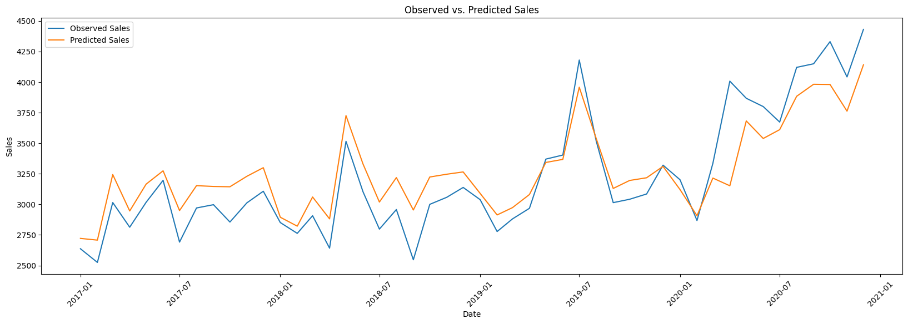
COMPARISON: CASEY’S GENERAL STORE 2017-2020,
AVERAGE MONTHLY SALES PER STOREFRONT (PREDICTED VS. OBSERVED)
FINAL MODEL
ROBUST SALES PREDICTIONS, VALUABLE GROWTH INSIGHTS
Notes:
We have developed a predictive model that has exceptional predictive power and provides valuable insights into the precise drivers of sales growth.
We created this for Casey’s and we can create this for Booze R Us

